Slide 1
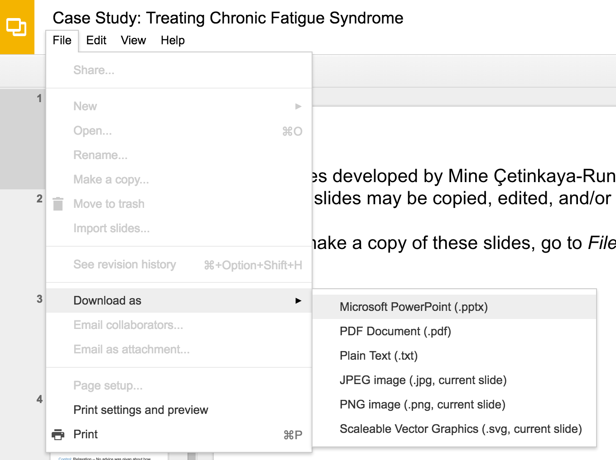
Slides developed by Mine Çetinkaya-Rundel of OpenIntro
Translated from LaTeX to Google Slides by Curry W. Hilton of OpenIntro.
The slides may be copied, edited, and/or shared via the CC BY-SA license
To make a copy of these slides, go to File > Download as > [option], as shown below. Or if you are logged into a Google account, you can choose Make a copy... to create your own version in Google Drive.

Slide 2
Computing the power for a 2-sample test
Slides developed by Mine Çetinkaya-Rundel of OpenIntro
Translated from LaTeX to Google Slides by Curry W. Hilton of OpenIntro.
The slides may be copied, edited, and/or shared via the CC BY-SA license
Some images may be included under fair use guidelines (educational purposes)

Slide 3
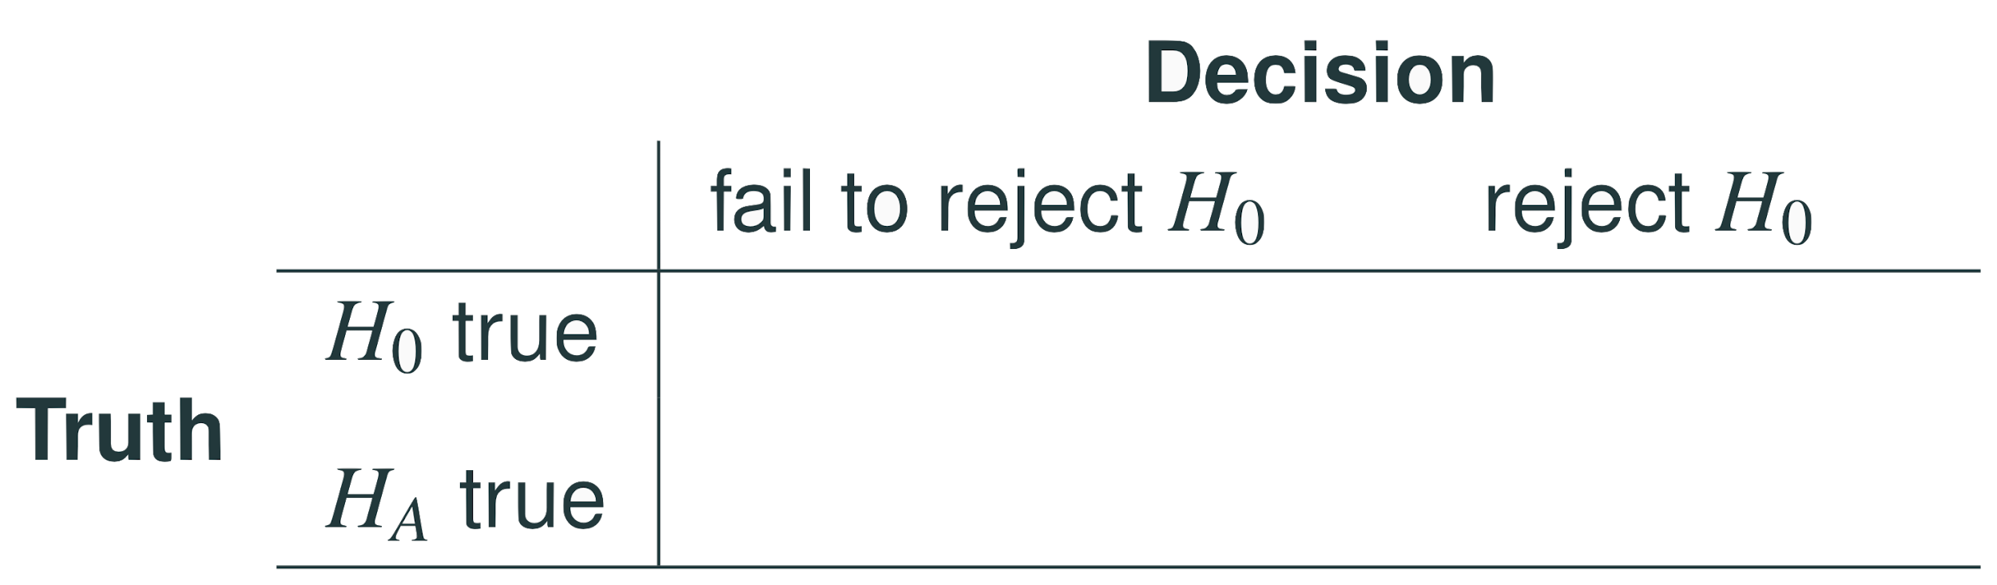

Slide 4
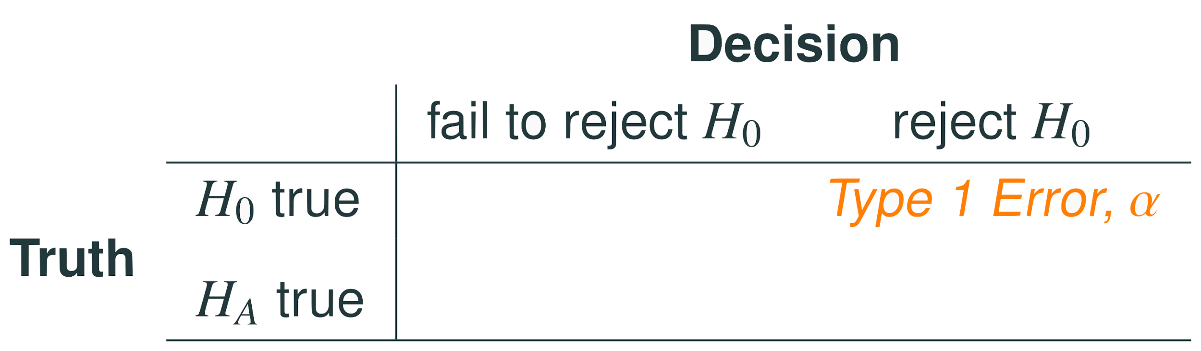
Type 1 error is rejecting H₀ when you shouldn’t have, and the probability of doing so is α (significance level)

Slide 5
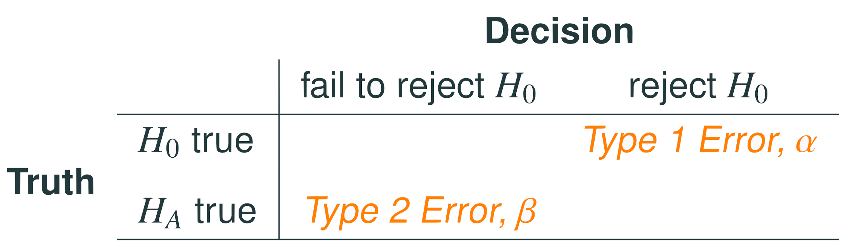
Type 1 error is rejecting H₀ when you shouldn’t have, and the probability of doing so is α (significance level)
Type 2 error is failing to reject H₀ when you should have, and the probability of doing so is β (a little more complicated to calculate)

Slide 6
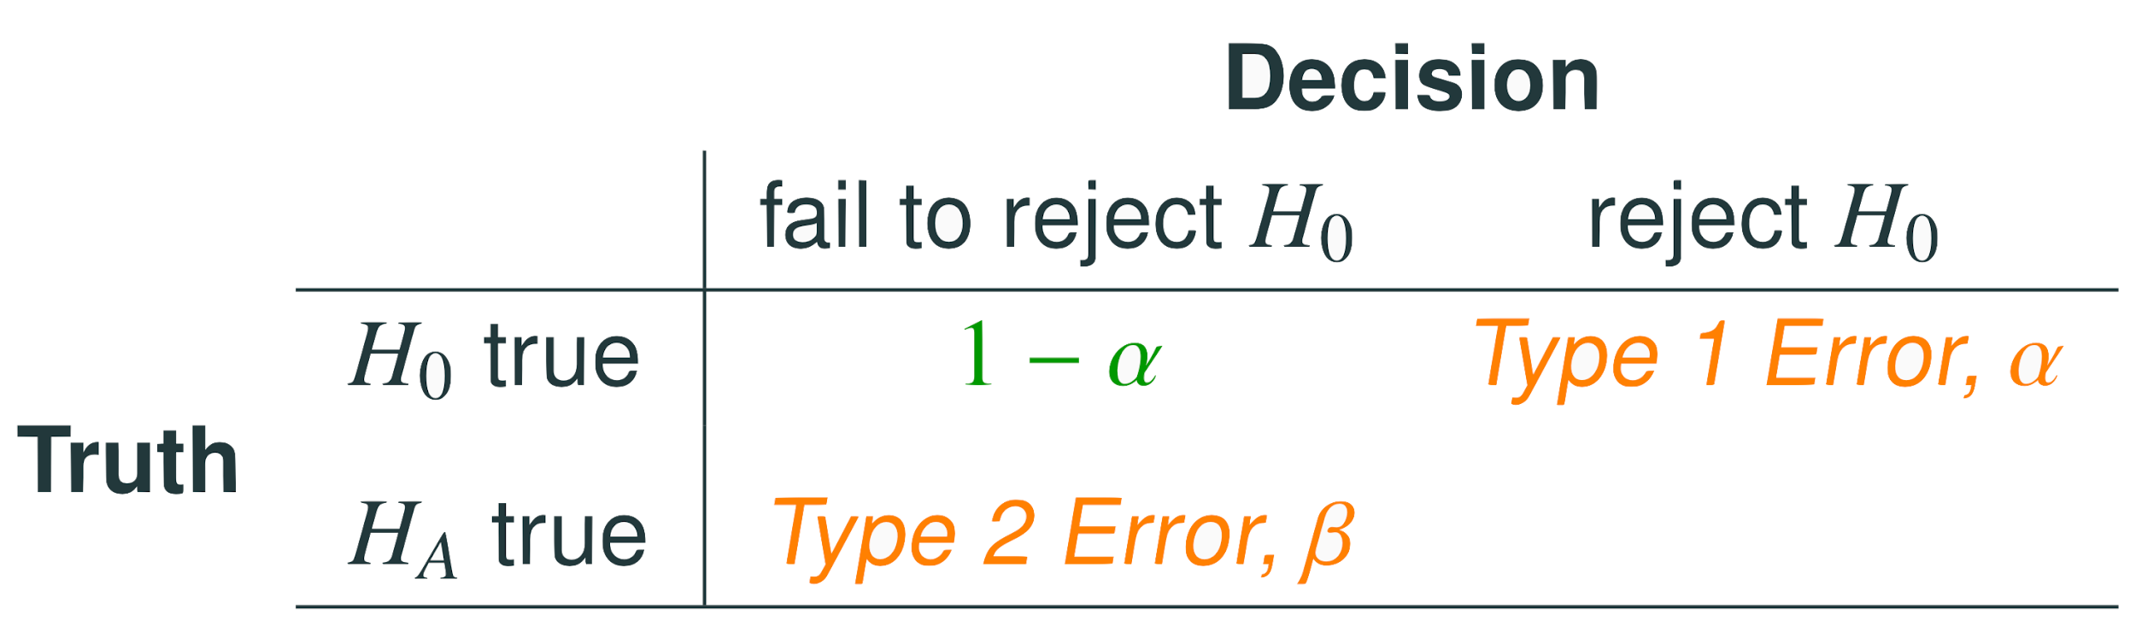
Type 1 error is rejecting H₀ when you shouldn’t have, and the probability of doing so is α (significance level)
Type 2 error is failing to reject H₀ when you should have, and the probability of doing so is β (a little more complicated to calculate)
Power of a test is the probability of correctly rejecting H₀, and the probability of doing so is 1 − β

Slide 7
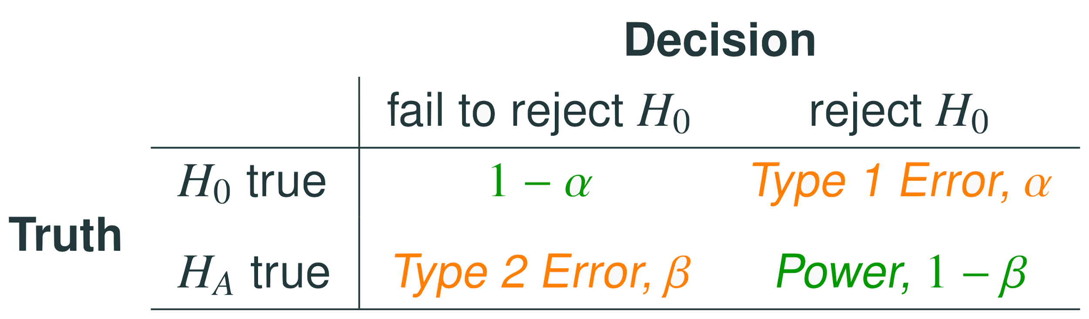
Type 1 error is rejecting H₀ when you shouldn’t have, and the probability of doing so is α (significance level)
Type 2 error is failing to reject H₀ when you should have, and the probability of doing so is β (a little more complicated to calculate)
Power of a test is the probability of correctly rejecting H₀, and the probability of doing so is 1 − β
In hypothesis testing, we want to keep α and β low, but there are inherent trade-offs

Slide 8
Type 2 error rate
If the alternative hypothesis is actually true, what is the chance that we make a Type 2 Error, i.e. we fail to reject the null hypothesis even when we should reject it?
The answer is not obvious
If the true population average is very close to the null hypothesis value, it will be difficult to detect a difference (and reject H₀)
If the true population average is very different from the null hypothesis value, it will be easier to detect a difference
Clearly, β depends on the effect size (ẟ)

Slide 9
Example - Blood Pressure (BP), hypotheses
Suppose a pharmaceutical company has developed a new drug for lowering blood pressure, and they are preparing a clinical trial to test the drug’s effectiveness. They recruit people who are taking a particular standard blood pressure medication, and half of the subjects are given the new drug (treatment) and the other half continue to take their current medication through generic-looking pills to ensure blinding (control). What are the hypotheses for a two-sided hypothesis test in this context?

Slide 10

Example - Blood Pressure (BP), hypotheses
Suppose a pharmaceutical company has developed a new drug for lowering blood pressure, and they are preparing a clinical trial to test the drug’s effectiveness. They recruit people who are taking a particular standard blood pressure medication, and half of the subjects are given the new drug (treatment) and the other half continue to take their current medication through generic-looking pills to ensure blinding (control). What are the hypotheses for a two-sided hypothesis test in this context?

Slide 11
Example - BP, standard error
Suppose researchers would like to run the clinical trial on patients with systolic blood pressures between 140 and 180 mmHg. Suppose previously published studies suggest that the standard deviation of the patients’ blood pressures will be about 12 mmHg and the distribution of patient blood pressures will be approximately symmetric. If we had 100 patients per group, what would be the approximate standard error for difference in sample means of the treatment and control groups?

Slide 12

Example - BP, standard error
Suppose researchers would like to run the clinical trial on patients with systolic blood pressures between 140 and 180 mmHg. Suppose previously published studies suggest that the standard deviation of the patients’ blood pressures will be about 12 mmHg and the distribution of patient blood pressures will be approximately symmetric. If we had 100 patients per group, what would be the approximate standard error for difference in sample means of the treatment and control groups?

Slide 13
Example - BP, minimum effect size required to reject H₀
For what values of the difference between the observed averages of blood pressure in treatment and control groups (effect size) would we reject the null hypothesis at the 5% significance level?

Slide 14
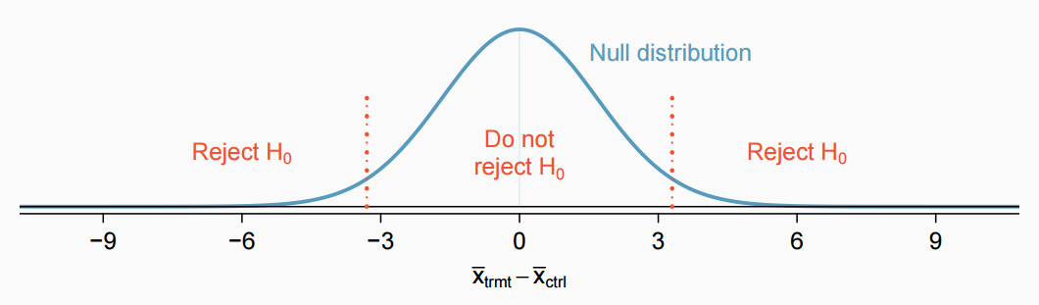
Example - BP, minimum effect size required to reject H₀
For what values of the difference between the observed averages of blood pressure in treatment and control groups (effect size) would we reject the null hypothesis at the 5% significance level?

Slide 15
Example - BP, minimum effect size required to reject H₀
For what values of the difference between the observed averages of blood pressure in treatment and control groups (effect size) would we reject the null hypothesis at the 5% significance level?
The difference should be at least
1.96 * 1.70 = 3.332
or at most
-1.96 * 1.70 = -3.332

Slide 16
Example - BP, power
Suppose that the company researchers care about finding any effect on blood pressure that is 3 mmHg or larger vs the standard medication. What is the power of the test that can detect this effect?

Slide 17
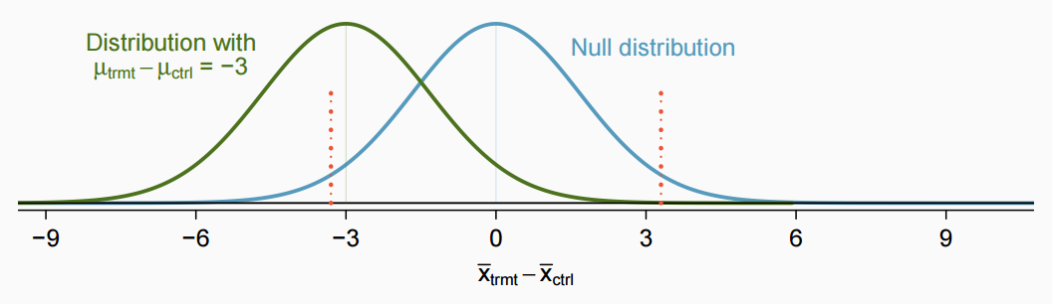
Example - BP, power
Suppose that the company researchers care about finding any effect on blood pressure that is 3 mmHg or larger vs the standard medication. What is the power of the test that can detect this effect?

Slide 18

Example - BP, power
Suppose that the company researchers care about finding any effect on blood pressure that is 3 mmHg or larger vs the standard medication. What is the power of the test that can detect this effect?

Slide 19

Example - BP, power
Suppose that the company researchers care about finding any effect on blood pressure that is 3 mmHg or larger vs the standard medication. What is the power of the test that can detect this effect?

Slide 20
Example - BP, required sample size for 80% power
What sample size will lead to a power of 80% for this test?

Slide 21
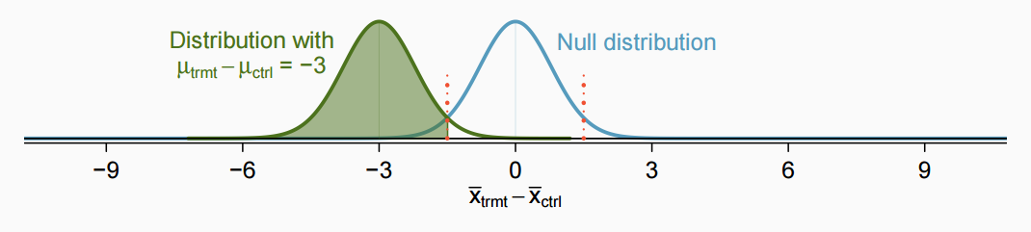
Example - BP, required sample size for 80% power
What sample size will lead to a power of 80% for this test?

Slide 22

Example - BP, required sample size for 80% power
What sample size will lead to a power of 80% for this test?

Slide 23

Example - BP, required sample size for 80% power
What sample size will lead to a power of 80% for this test?

Slide 24

Example - BP, required sample size for 80% power
What sample size will lead to a power of 80% for this test?

Slide 25
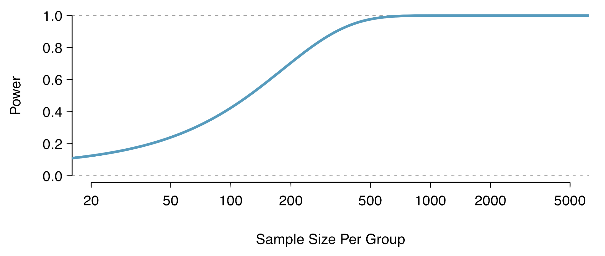
Recap
Calculate required sample size for a desired level of power
Calculate power for a range of sample sizes, then choose the sample size that yields the target power (usually 80% or 90%)

Slide 26
Achieving desired power
There are several ways to increase power (and hence decrease type 2 error rate):

Slide 27
Achieving desired power
There are several ways to increase power (and hence decrease type 2 error rate):
Increase the sample size

Slide 28
Achieving desired power
There are several ways to increase power (and hence decrease type 2 error rate):
Increase the sample size
Decrease the standard deviation of the sample, which essentially has the same effect as increasing the sample size (it will decrease the standard error). With a smaller s we have a better chance of distinguishing the null value from the observed point estimate. This is difficult to ensure but cautious measurement process and limiting the population so that it is more homogenous may help

Slide 29
Achieving desired power
There are several ways to increase power (and hence decrease type 2 error rate):
Increase the sample size
Decrease the standard deviation of the sample, which essentially has the same effect as increasing the sample size (it will decrease the standard error). With a smaller s we have a better chance of distinguishing the null value from the observed point estimate. This is difficult to ensure but cautious measurement process and limiting the population so that it is more homogenous may help
Increase α, which will make it more likely to reject H₀ (but note that this has the side effect of increasing the Type 1 error rate)

Slide 30
Achieving desired power
There are several ways to increase power (and hence decrease type 2 error rate):
Increase the sample size
Decrease the standard deviation of the sample, which essentially has the same effect as increasing the sample size (it will decrease the standard error). With a smaller s we have a better chance of distinguishing the null value from the observed point estimate. This is difficult to ensure but cautious measurement process and limiting the population so that it is more homogenous may help
Increase α, which will make it more likely to reject H₀ (but note that this has the side effect of increasing the Type 1 error rate)
Consider a larger effect size. If the true mean of the population is in the alternative hypothesis but close to the null value, it will be harder to detect a difference

Slide 31
Find more resources at openintro.org/os, including
Slides
Videos
Statistical Software Labs
Discussion Forums (free support for students and teachers)
Learning Objectives
Teachers only content is also available for Verified Teachers, including
Exercise solutions
Sample exams
Ability to request a free desk copy for a course
Statistics Teachers email group
Questions? Contact us.

Slide 32
Extra Slides from the OS3 section on power calculations

